Slide 1
MIS 321
Compound Design Patterns

Slide 2
Compound Pattern
Patterns are often used together and combined within the same design solution.
A compound pattern combines two or more patterns into a solution that solves a recurring or general problem.

Slide 3
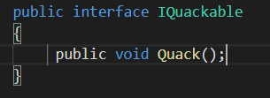
Example
Let’s put some starter code in place to see this in action.
We’ll return to our Duck example from the start of the semester
Step 1 - Start by creating a IQuackable Interface
IQuackables just need to
know how to quack

Slide 4
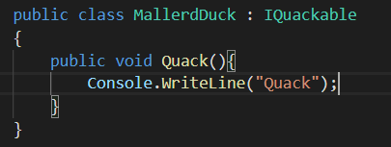
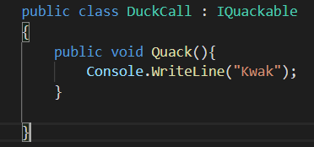
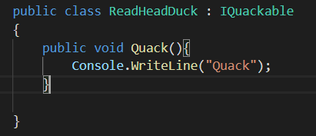
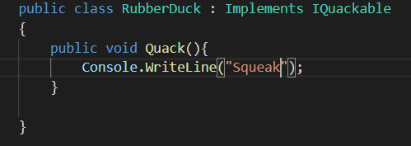
Example
Step 2 – Create Duck classes that implement IQuackable
Some Odd Sounding
“Ducks”
Standard
Ducks

Slide 5
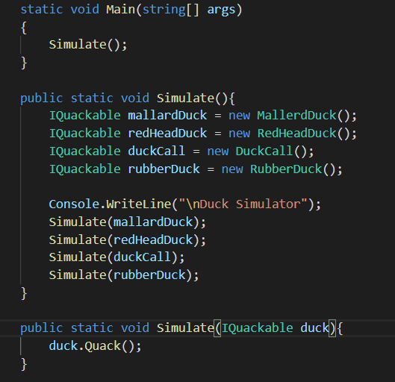
Example
Step 3 – Let’s create some code to test with.
Create 1 duck of each type to test with
Simulate each one
Overload the simulate method to simulate just 1 duck. Polymorphism does it’s thing and no matter what type of IQuackable gets passed in, the method works

Slide 6
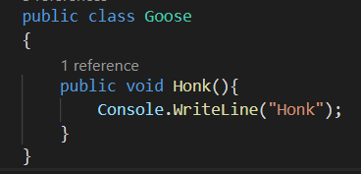
Example
Step 4 – If there are ducks around, there are likely geese in the area.
A Goose Honks, it doesn’t Quack!

Slide 7
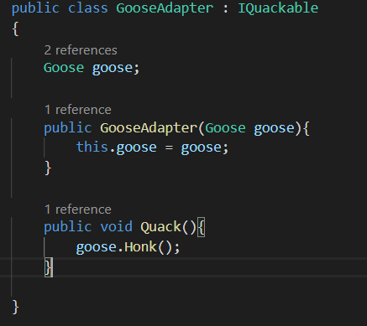
Add an Adapter
Step 5 – But geese don’t quack. Our main program expects the Quackable interface.
Good news is we know how to solve this
Let’s create an adaptor wrapper
Adapter implements the target interface
The constructor takes the goose we are going to adapt
The adaption is made. We call the Honk from the Quack

Slide 8
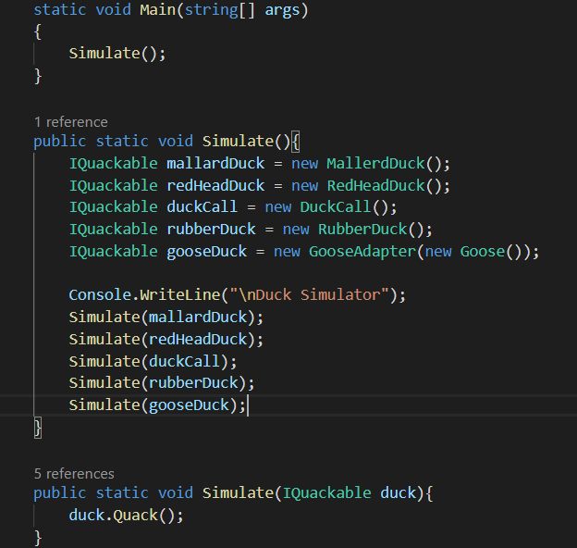
Add an Adapter
Step 5 Continued – Let’s update our main class to implement our wrapper.
Add a Goose that acts like a Duck by wrapping it in the GooseAdapter
After it’s wrapped, we can treat it like any other IQuackable.

Slide 9
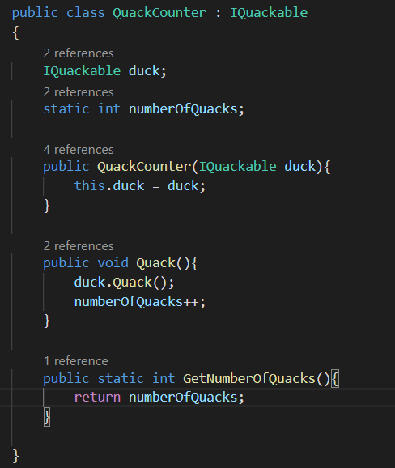
Add a Decorator
Step 6 Let’s add some functionality to our app. Let’s implement a decorator wrapper and add the ability to count quacks.
Implement target interface
Instance var to hold quacker we’re decorating
Static var to hold count
Get ref to IQuackable we’re decorating in constructor
Delegate the Quack call to the instance we are decorating
Add to the count
Method to return the count

Slide 10
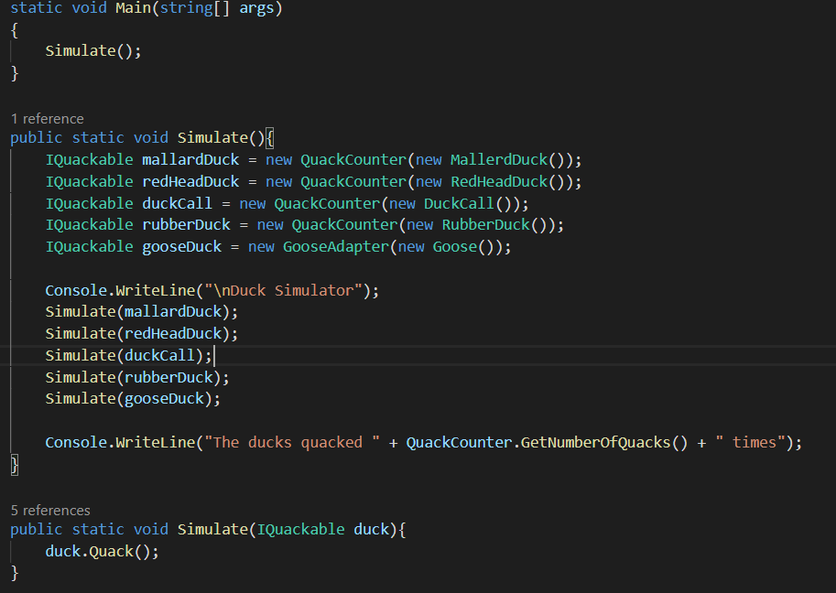
Add a Decorator
Step 6 Continued – Update main to use the wrapper.
Wrap each IQuackable in our new decorator.
Except, geese don’t quack, so let’s not wrap it.
Write out the number of quacks

Slide 11
Add a Factory
Wrapping the IQuackables can get us in trouble. We don’t always remember to do it and we don’t always do it right.
Let’s look a t a new pattern to help get ducks created. It’s called the Factory Pattern

Slide 12
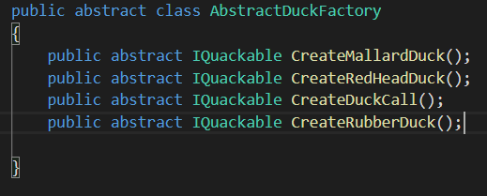
Add a Factory
Factory pattern is a creational pattern that uses factory methods to deal with the problem of creating objects without having to specify the exact class of the object that will be created.
Define an abstract factory class that subclasses will implement to create different families.
Each method creates 1 type of duck

Slide 13
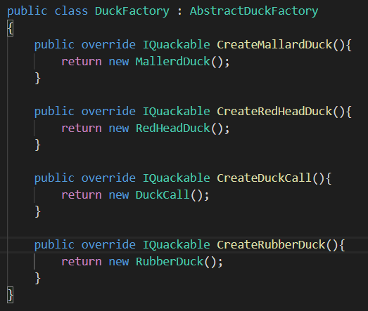
Add a Factory
1st create a factory that creates ducks without a decorator just to practice creating a factory.
DuckFactory extends the abstract factory
Each method creates a particular kind of IQuackable. The actual type is known to the application asking for it. It just knows it’s getting an Iquackable.

Slide 14
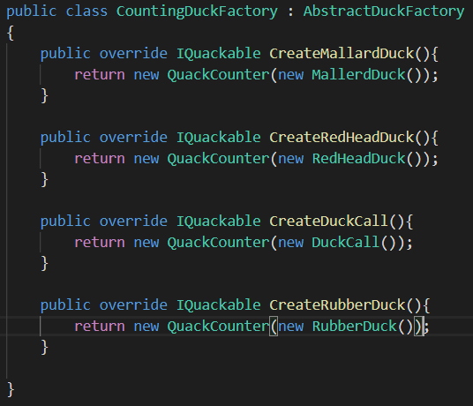
Add a Factory
Now let’s create the factory we actually need that counts ducks!
Still extend the abstract factory
Each method wraps the IQuackable with the quack counting decorator. Our main method doesn’t need to know the difference. It just knows it’s getting an IQuackable back.

Slide 15
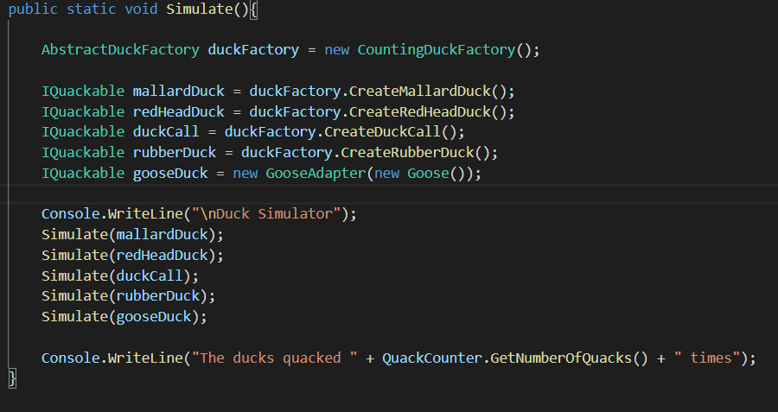
Add a Factory
Update our simulator to use the factory.
Create the factory object
Use the factory to create the ducks instead of instantiating them directly

